Slide 1



Web App for Gender Classification
Name: Anmol Raj | Registration No.: 11908117
Name: Eeshan Srivastava | Registration No.: 11907794
Name: Kanna Kalyan | Registration No.: 11905161
Name: Gutti Venkata Subbarao | Registration No.: 11905331

Slide 2
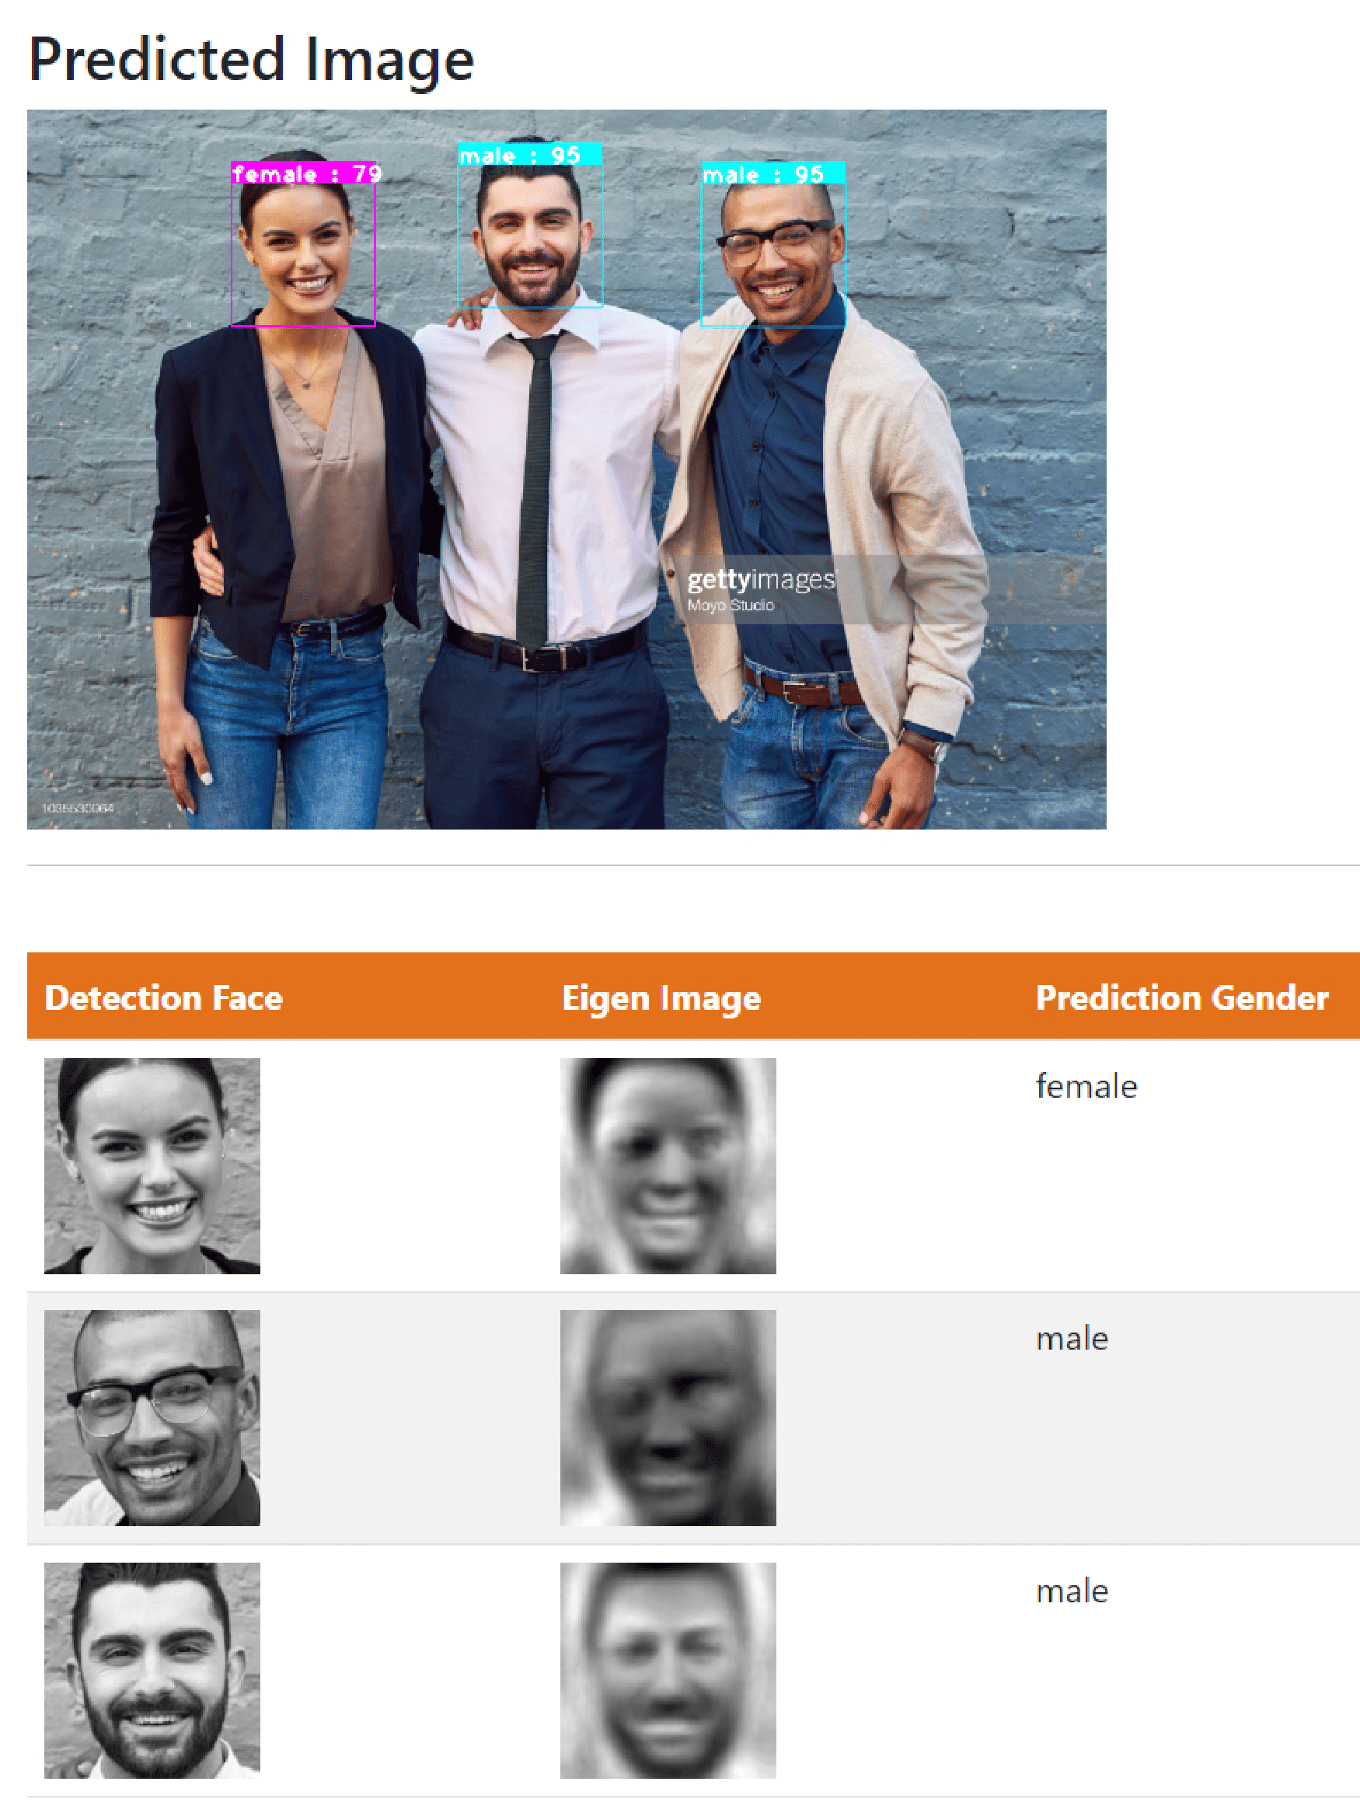
What is this Project
Gender Classification Web App - Automatically detect faces in photos, then use a machine learning model to classify gender. Finally, integrate the machine learning model into a Flask app
Notes:
Objectives:
Develop a machine learning model that can accurately classify the gender of individuals in photos with at least 85% accuracy.
Build a user-friendly web application using the Flask framework that allows users to upload photos and receive the gender classification results in real-time.

Slide 3

Use case of a gender classification web app
Identifying gender demographics
Identifying gender biases
Improving marketing strategies
Enhancing security
Promoting diversity and inclusion
Notes:
Identifying gender demographics: The app can be used to identify the gender demographics of a specific group, such as attendees at a conference, students in a class, or employees in a company.
Identifying gender biases: The app can be used to identify gender biases in images or videos, such as in advertising or media.
Improving marketing strategies: The app can be used to improve marketing strategies by providing information about the gender of potential customers.
Enhancing security: The app can be used in security systems to automatically detect the gender of individuals and identify potential security risks or threats.
Promoting diversity and inclusion: The app can be used to promote diversity and inclusion by providing accurate and inclusive gender identification.

Slide 4
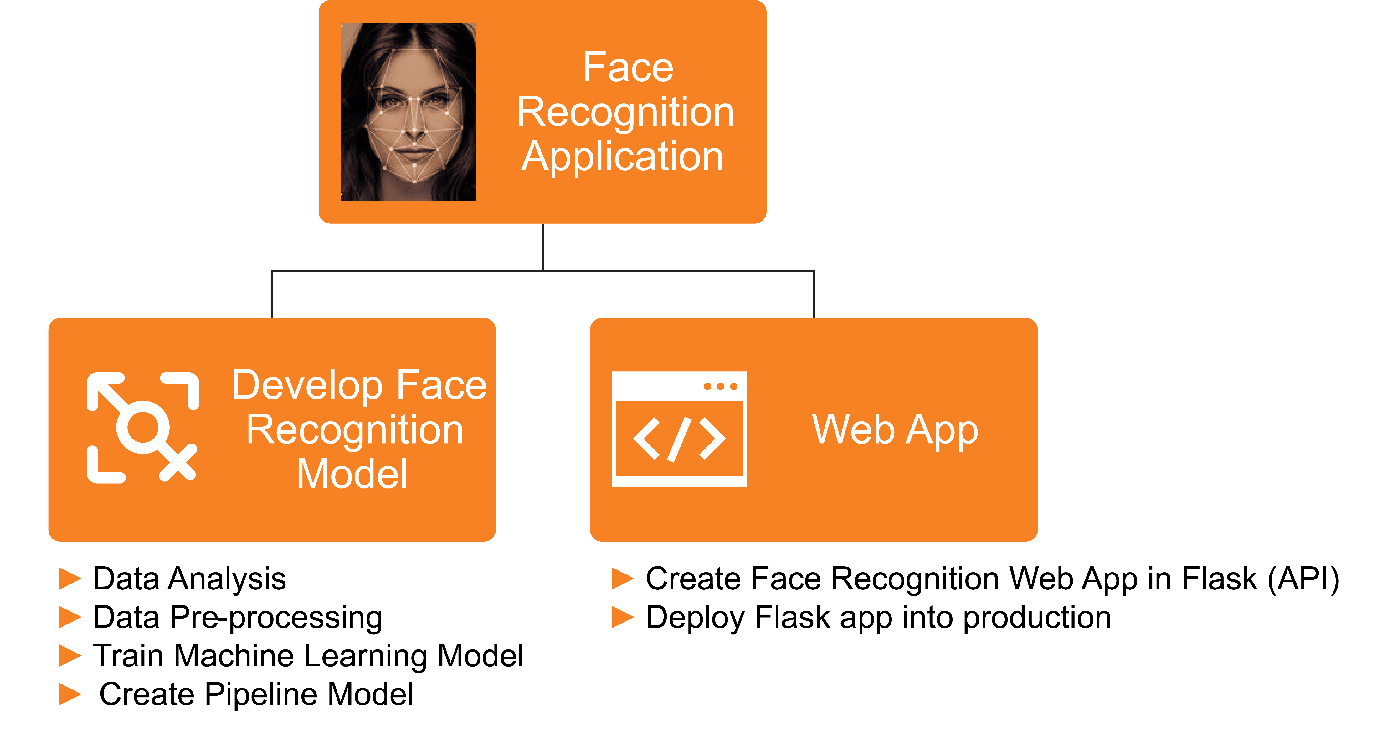
Methodology of a gender classification web app
Notes:
There are two step of it:
In the first step we build and trained the face recognition model using Machine Learning
Then we developed the Web app using Flask
Now we will proceed to Face recognition model development

Slide 5
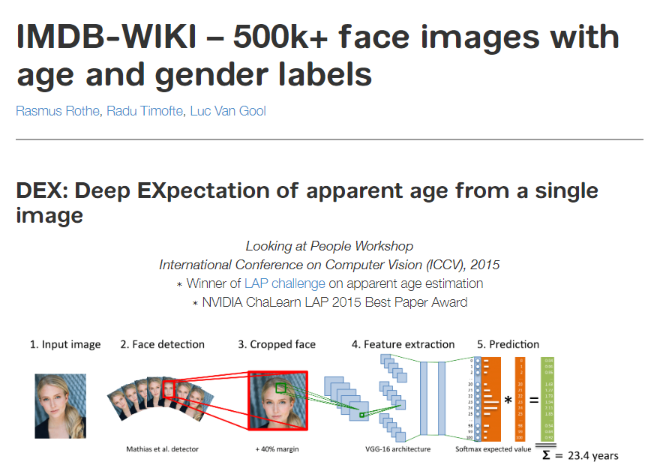
Methodology of a gender classification web app
We used data from the IMDB wiki
https://data.vision.ee.ethz.ch/cvl/rrothe/imdb-wiki/
Notes:
So, for the we have used IMDB wiki data, but it has 500k+ face images with age and gender label so we used the data with only the faces and according to the instruction given the website we preprocessed the data and get the proper face data having gender label

Slide 6


Training Flow
Data Pre-processing
Images Data
Train
Machine Learning Model
Save ML model
Detect Face
Structure Images
& Labelling
Extract Features
► Detect Faces using
Haar Cascade Classifier
► Crop Faces from Images
► Label Each Image
► Unstructured dimension of cropped images to structured image dimension
► OpenCV resize module to make structure
► Eigen Faces
► Use PCA to extract features from Faces.
Notes:
So, we have data from those images we did the data preprocessing. And from that preprocessed data or a structured data, we used that data to train our machine and save our ML model

Slide 7
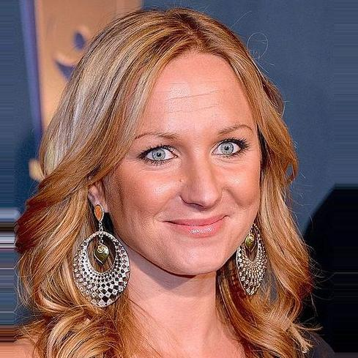
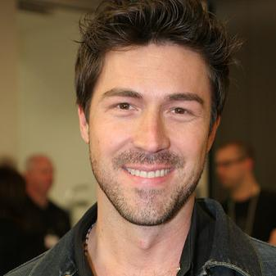
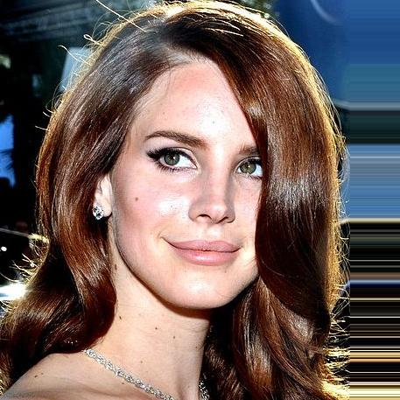
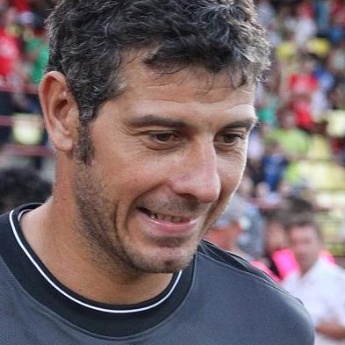
Training Flow
Data Pre-processing
Images Data
Train
Machine Learning Model
Save ML model
Detect Face
Structure Images
& Labelling
Extract Features
► Detect Faces using
Haar Cascade Classifier
► Crop Faces from Images
► Label Each Image
► Unstructured dimension of cropped images to structured image dimension
► OpenCV resize module to make structure
► Eigen Faces
► Use PCA to extract features from Faces.
Notes:
However, In data preprocessing, we can split this into three sub modules

Slide 8
Training Flow
Data Pre-processing
Images Data
Train
Machine Learning Model
Save ML model
Detect Face
Structure Images
& Labelling
Extract Features
► Detect Faces using
Haar Cascade Classifier
► Crop Faces from Images
► Label Each Image
► Unstructured dimension of cropped images to structured image dimension
► OpenCV resize module to make structure
► Eigen Faces
► Use PCA to extract features from Faces.
Notes:
Step 1: We need to detect the face - using Haar cascade classifier (OpenCV Haar Cascade is a machine learning-based approach for object detection. It is a popular algorithm used for detecting faces) , we are going to identify the coordinates of the face and crop the face and we're going to save that into separate folder.

Slide 9
Training Flow
Data Pre-processing
Images Data
Train
Machine Learning Model
Save ML model
Detect Face
Structure Images
& Labelling
Extract Features
► Detect Faces using
Haar Cascade Classifier
► Crop Faces from Images
► Label Each Image
► Unstructured dimension of cropped images to structured image dimension
► OpenCV resize module to make structure
► Eigen Faces
► Use PCA to extract features from Faces.
Notes:
Step 2: Structure and labeling - Since the dimension of the face that we extracted is highly irregular or unstructured and we did the exploratory data analysis and using the exploratory data analysis adjusted the width and height of the crop faces properly, and then we will convert that into the grayscale for further processing

Slide 10
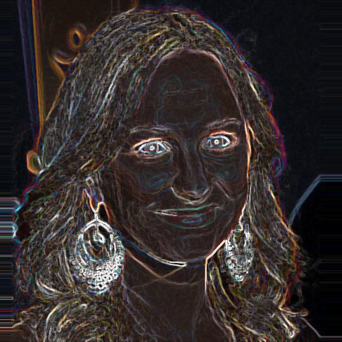
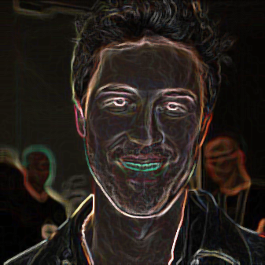
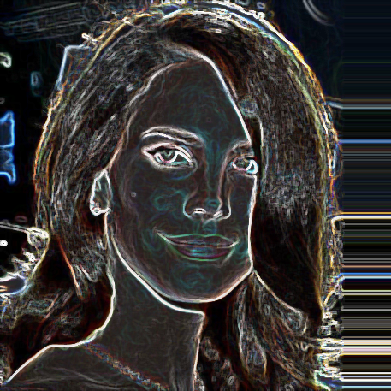
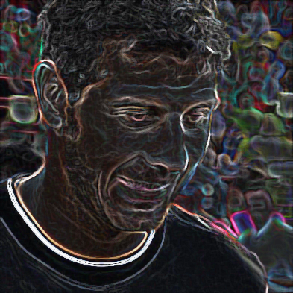
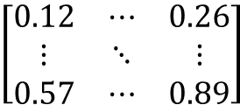
Training Flow
Data Pre-processing
Images Data
Train
Machine Learning Model
Save ML model
Detect Face
Structure Images
& Labelling
Extract Features
► Detect Faces using
Haar Cascade Classifier
► Crop Faces from Images
► Label Each Image
► Unstructured dimension of cropped images to structured image dimension
► OpenCV resize module to make structure
► Eigen Faces
► Use PCA to extract features from Faces.
$$\left[\begin{matrix}0.12 & ⋯ & 0.26 \\ ⋮ & ⋱ & ⋮ \\ 0.57 & ⋯ & 0.89\end{matrix}\right]$$
Notes:
Step 3: extracting the feature from faces – We used the eigen face approach using the Principal component analysis (PCA) extract the features from the faces And finally, we will convert that into the numerical python array.

Slide 11


Training Flow
Data Pre-processing
Images Data
Train
Machine Learning Model
Save ML model
Detect Face
Structure Images
& Labelling
Extract Features
► Detect Faces using
Haar Cascade Classifier
► Crop Faces from Images
► Label Each Image
► Unstructured dimension of cropped images to structured image dimension
► OpenCV resize module to make structure
► Eigen Faces
► Use PCA to extract features from Faces.
$$\left[\begin{matrix}0.12 & ⋯ & 0.26 \\ ⋮ & ⋱ & ⋮ \\ 0.57 & ⋯ & 0.89\end{matrix}\right]$$

Slide 12
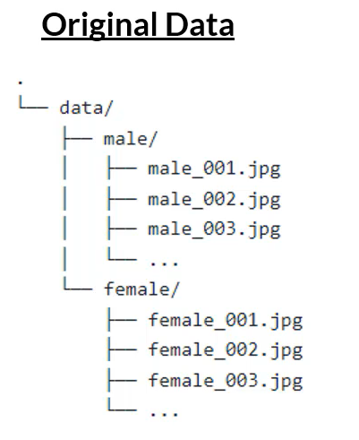
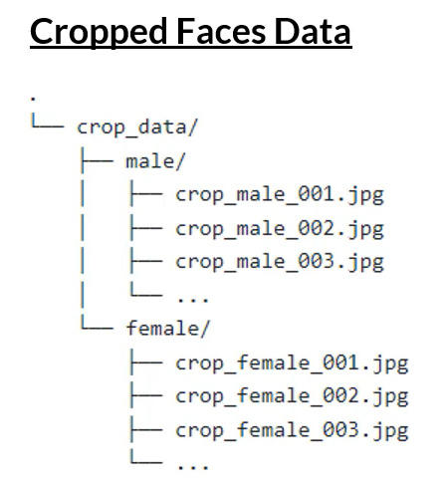

Data Pre-processing – Cropping faces
Notes:
Using Haar cascade classifier we crop the face and saved that into separate folder.

Slide 13
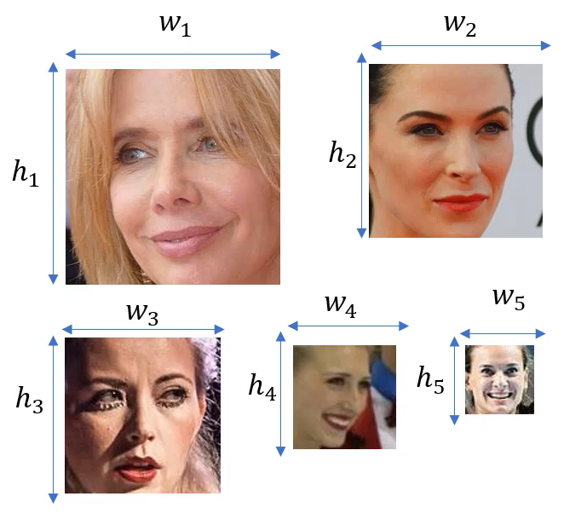
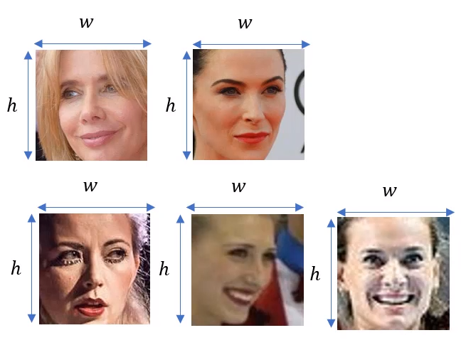
Data Pre-processing – Structure Images
Notes:
In this process, we are basically going to convert all images into same size. What is a width and height of the image that we need to resize? And for that we perform Exploratory Data Analysis

Slide 14
Exploratory Data Analysis
Distribution of Male and Female
Bar Chart
Pie Chat
What Distribution of size of all Images
Histogram
Box Plot
Spilt by “Gender”
Make the decision of width and height to resize using above chart
Remove the few images that are having very less size

Slide 15
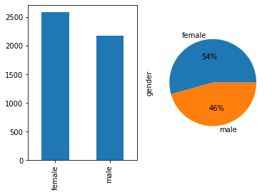
Distribution of Male and Female

Slide 16
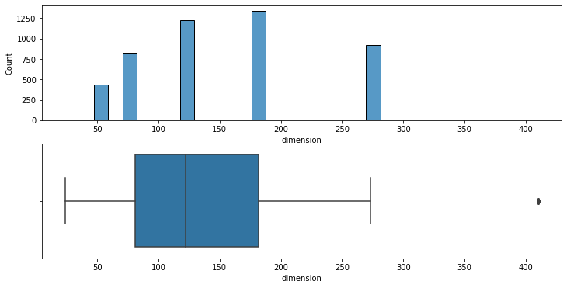
Distribution of size of all Images
Notes:
Analyzing the data – we can say nearly 75% of the data are basically having the width or height of the image is more than 80
We can use the 100 by 100 as dimension as it is somewhere median of our data

Slide 17
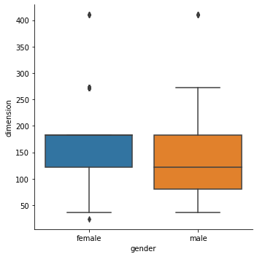
Distribution of size of Male and Female
Notes:
Conclusion
1. We have almost equal distribution of gender (numbers)
2. Most of the images are having dimension more than 60
3. Female most of the female images are HD compared to male images

Slide 18
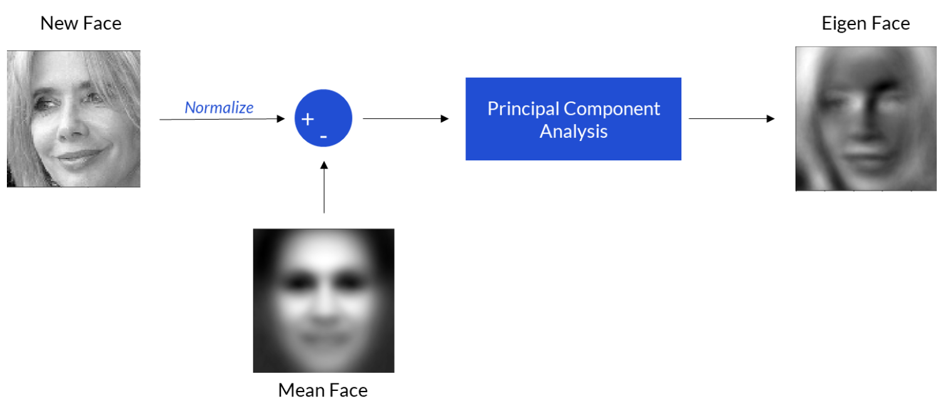
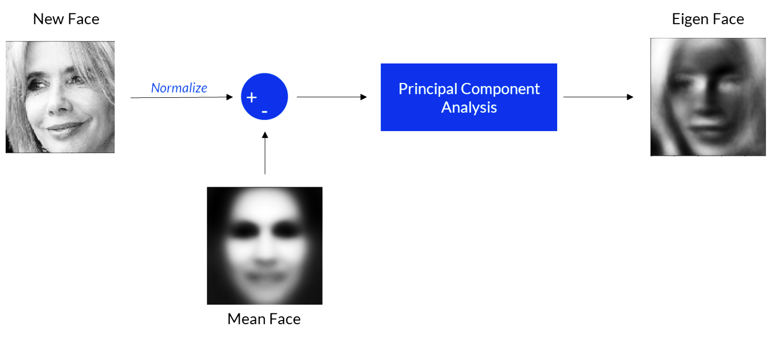
Eigenface approach using PCA

Slide 19
Why eigenface approach using PCA
The eigenface approach is a well-established method for facial recognition that utilizes PCA
PCA and the eigenface approach can reduce the dimensionality of the data
PCA and the eigenface approach allowing for faster and more efficient computation of facial recognition algorithms
PCA and the eigenface approach can help to overcome issues such as lighting and pose variations in the images
Notes:
The eigenface approach is a well-established method for facial recognition that utilizes PCA - In this approach, a set of face images are used to create a covariance matrix which is then used to determine the eigenfaces, which represent the most significant variations in the set of images.

Slide 20
scikit-learn
train_test_split
model_selection
It splits arrays or matrices into random subsets for train and test data, respectively
module provides various functions to cross-validate our model, tune the estimator's hyperparameters, or produce validation and learning curves
GridSearchCV
sklearn
It is a popular hyperparameter tuning technique used in machine learning
SVM
Support vector machines is a set of supervised learning methods used for classification, regression and outliers' detection
SVC
It is a variant of the SVM algorithm, which is specifically designed for classification problems
Notes:
We are using scikit learn for ml model - As it is simple and efficient tools for predictive data analysis
Sklearn's model selection module provides various functions to cross-validate our model, tune the estimator's hyperparameters, or produce validation and learning curves.
Support vector machines (SVMs) are a set of supervised learning methods used for classification, regression and outliers' detection
sklearn.model_selection import train_test_split - splits arrays or matrices into random subsets for train and test data, respectively
This function helps to loop through predefined hyperparameters and fit your estimator (model) on your training set

Slide 21
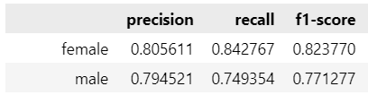
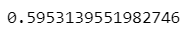
Model Evaluation
Classification Report
Precision, Recall, F1-Score
Kappa Score
-ve (worst model)
0 to 0.5 (bad model)
0.5 to 0.7 (Good Model)
0.7 to 0.9 (Excellent Model)
0.9 to 1.0 (Perfect Model)
AUC
Less than 0.5 (Worst Model)
0.5 to 0.6 (Bad Model)
0.6 to 0.8 (Good Model)
0.8 to 0.9 (Excellent Model)
0.9 to 1.0 (Perfect Model)

Slide 22
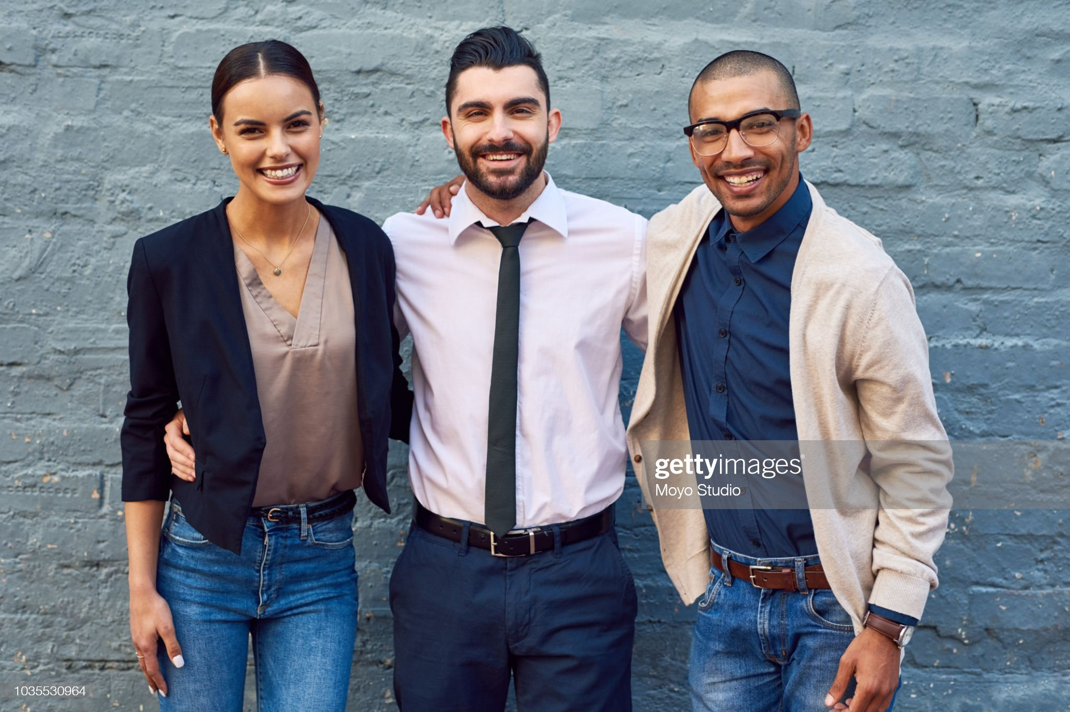
Need of Pipeline
Notes:
So, in order to do such kind of things we have to combine all three processes That is data preprocessing, feature extraction and the face recognition model.
We combined everything and then we created pipeline and to that pipeline if we pass the image, we get the predictions.

Slide 23
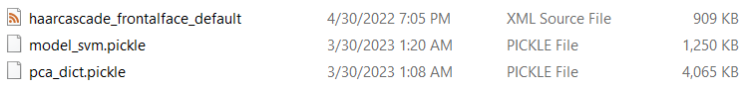
Model for the Pipeline
haarcascade_frontalface_default.xml – it used to detect the face object
model_svm.pickle – SVM our machine learning model
pca_dict.picklet – it contain PCA model and the mean face.
Notes:
So, in order to do such kind of things we have to combine all three processes That is data preprocessing, feature extraction and the face recognition model.
We combined everything and then we created pipeline and to that pipeline if we pass the image, we get the predictions.

Slide 24
Step for creating pipeline
Step-01: Read image
Step-02: Convert into gray scale
Step-03: Crop the face (using haar cascase classifier)
Step-04: Normalization (0-1)
Step-05: Resize images (100,100)
Step-06: Flattening (1x10000)
Step-07: Subtract with mean
Step-08: Get eigen image (apply roi_mean to pca)
Step-09: Eigen Image for Visualization
Step-10: Pass to ml model (svm) and get predictions
Step-11: Generate report
Notes:
So, in order to do such kind of things we have to combine all three processes That is data preprocessing, feature extraction and the face recognition model.
We combined everything and then we created pipeline and to that pipeline if we pass the image, we get the predictions.

Slide 25
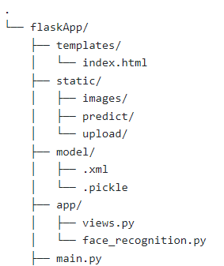
Folder Structure of Web Application with Flask
Create all html files
Create all static files like css, js, images, etc
Place all machine learning models
Python modules
Main flask file
Notes:
So, in order to do such kind of things we have to combine all three processes That is data preprocessing, feature extraction and the face recognition model.
We combined everything and then we created pipeline and to that pipeline if we pass the image, we get the predictions.

Slide 26
Pages of Web Application with Flask
Page-1 : Home Page
Page-2: Application Page
Page-3: Gender App Page
Notes:
So, in order to do such kind of things we have to combine all three processes That is data preprocessing, feature extraction and the face recognition model.
We combined everything and then we created pipeline and to that pipeline if we pass the image, we get the predictions.

Slide 27
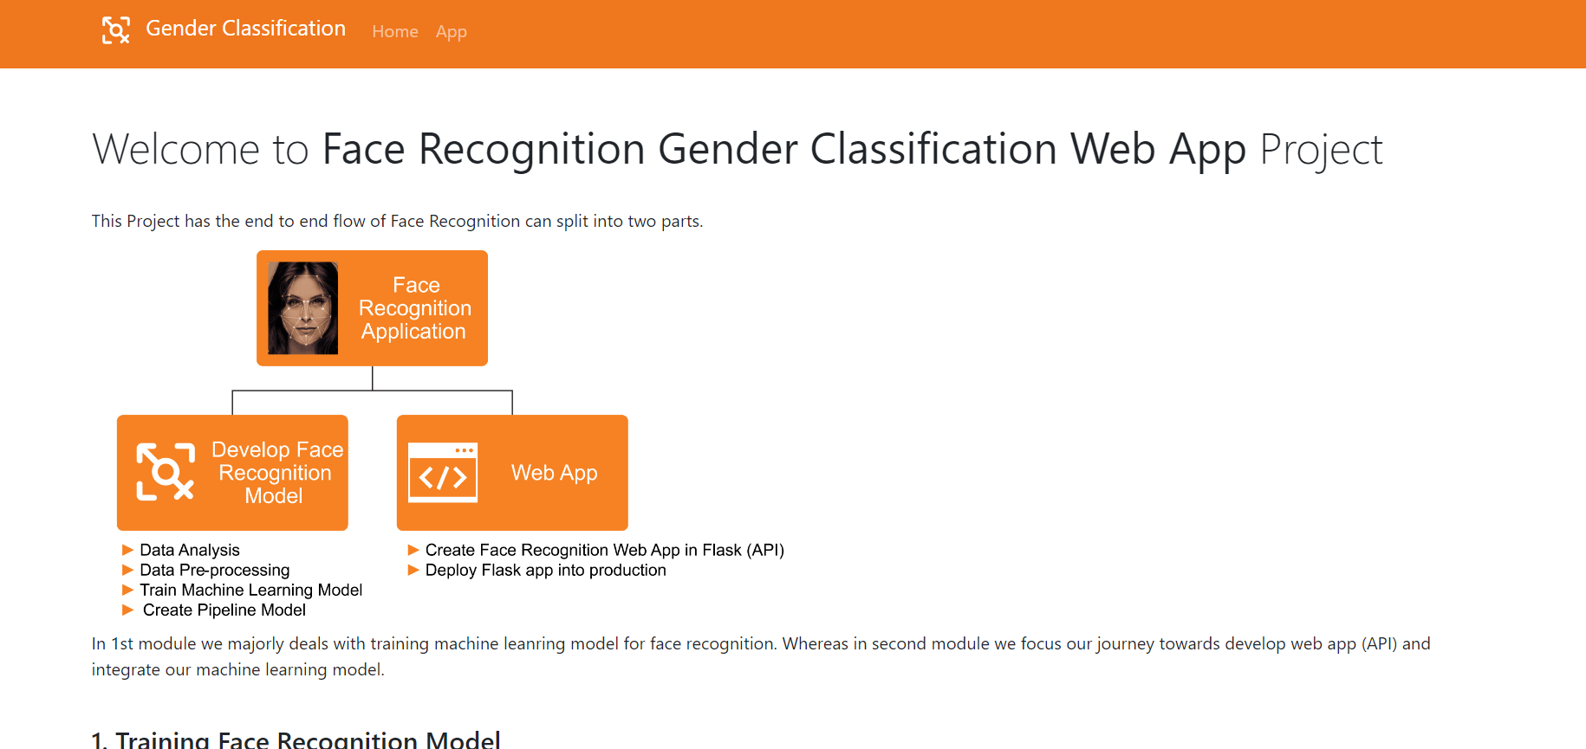
Page-1 : Home Page
Notes:
So, in order to do such kind of things we have to combine all three processes That is data preprocessing, feature extraction and the face recognition model.
We combined everything and then we created pipeline and to that pipeline if we pass the image, we get the predictions.

Slide 28
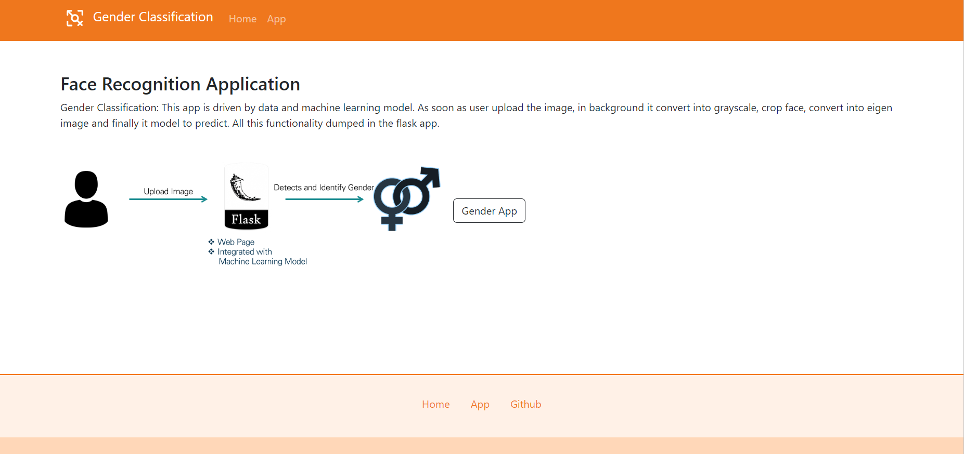
Page-2: Application Page
Notes:
So, in order to do such kind of things we have to combine all three processes That is data preprocessing, feature extraction and the face recognition model.
We combined everything and then we created pipeline and to that pipeline if we pass the image, we get the predictions.

Slide 29
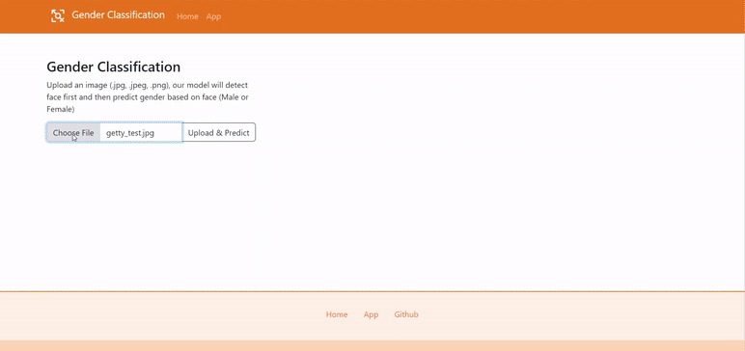
Page-3: Gender App Page
Notes:
So, in order to do such kind of things we have to combine all three processes That is data preprocessing, feature extraction and the face recognition model.
We combined everything and then we created pipeline and to that pipeline if we pass the image, we get the predictions.

Slide 30

Web Design with Bootstrap Framework
Bootstrap is a popular front-end framework that is used to create responsive and mobile-first websites and web applications.
Notes:
So, in order to do such kind of things we have to combine all three processes That is data preprocessing, feature extraction and the face recognition model.
We combined everything and then we created pipeline and to that pipeline if we pass the image, we get the predictions.

Slide 31

Deploy Web app to Railway
https://gender-classification-lpu-project.up.railway.app
Notes:
So, in order to do such kind of things we have to combine all three processes That is data preprocessing, feature extraction and the face recognition model.
We combined everything and then we created pipeline and to that pipeline if we pass the image, we get the predictions.

